Slide 1
Vision-based Robust UAV Navigation with Fiducial Markers in Coppeliasim
Final Project
Instructor: Dr. Abdullah Al Redwan Newaz
CSCI6650 - Intelligent Agents

Slide 2
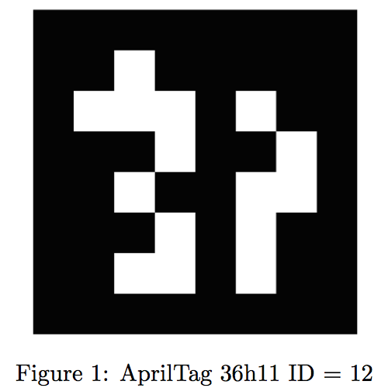
How Fiducial Markers Work ?
The black and white pattern within the tag represents a binary code, which can be decoded by computer vision algorithms. This code is often used to assign a unique identifier to each tag.
The cameras capture images of the tags within their field of view. The tag's unique pattern is then analyzed in the images.
Computer vision algorithms process the images to detect the presence of AprilTags.
Once the tag is detected and its binary code is read, the system can calculate the tag's pose with respect to the camera, which includes its position (x, y, z) and orientation (roll, pitch, yaw) in 3D space.

Slide 3
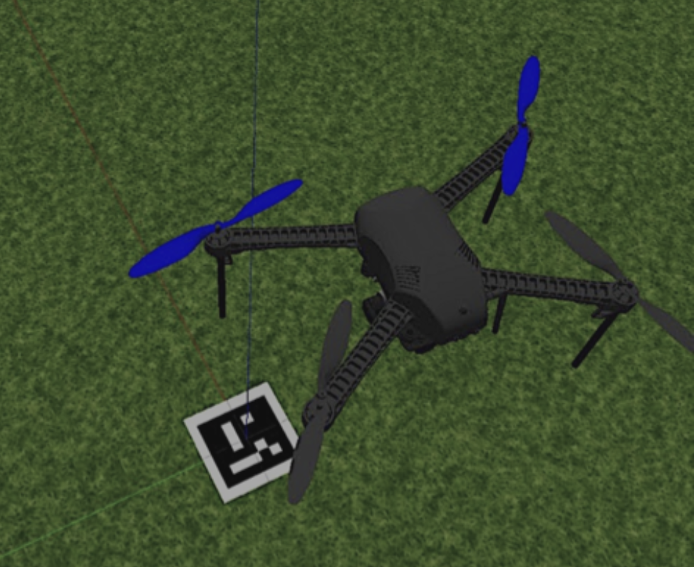
Fiducial Marker Detector
Detection of the tags With Yolov8
Estimating the drone’s position using tag detections and orientation using EPnP algorithm
State: position (x, y, z) , orientation (roll, pitch, yaw).
We will use a butterworth filter to reduce the noisy tag detections.
Notes:
They are dynamic in nature so state estimation provides the real-time updates on these changes. It forms the foundation for various robotic tasks, including navigation, control, and interaction with the environment.
State: drone position and orientation in 3d space.
We will discuss this later in the upcoming slides.

Slide 4
Why YOLO?
Yolo offers faster performance compared to other marker detection systems.
It can detect various tags beyond just apriltag, enhancing its generalizability.
Some marker detection systems exhibit noise, whereas Yolo tends to be less noisy, especially with a filter.

Slide 5
Motion Planning and Trajectory Generation

Slide 6

Motion Planning
Path Planning
Sequence of Waypoints
Task Planning
Start and Goal Position
Trajectory Generation
Minimum Jerk
Trajectory Following
Tracking to a predefined trajectory
Minimum snap
Maintaining Constant Velocity
Notes:
Minimum jerk minimizes the rate of change of acceleration
Minimum snap minimizes the rate of change of jerk, resulting in smoother flight.

Slide 7
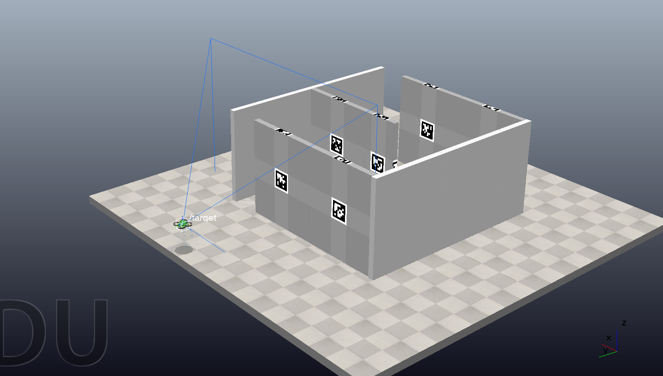
Simulated Environment:

Slide 8
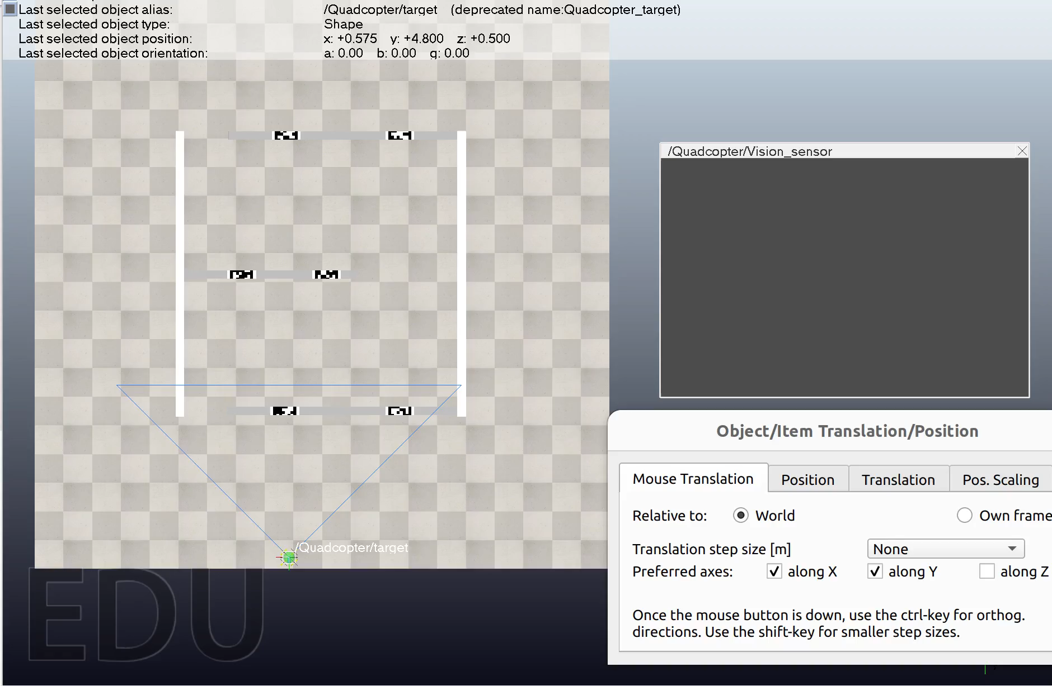
Simulated Environment:

Slide 9
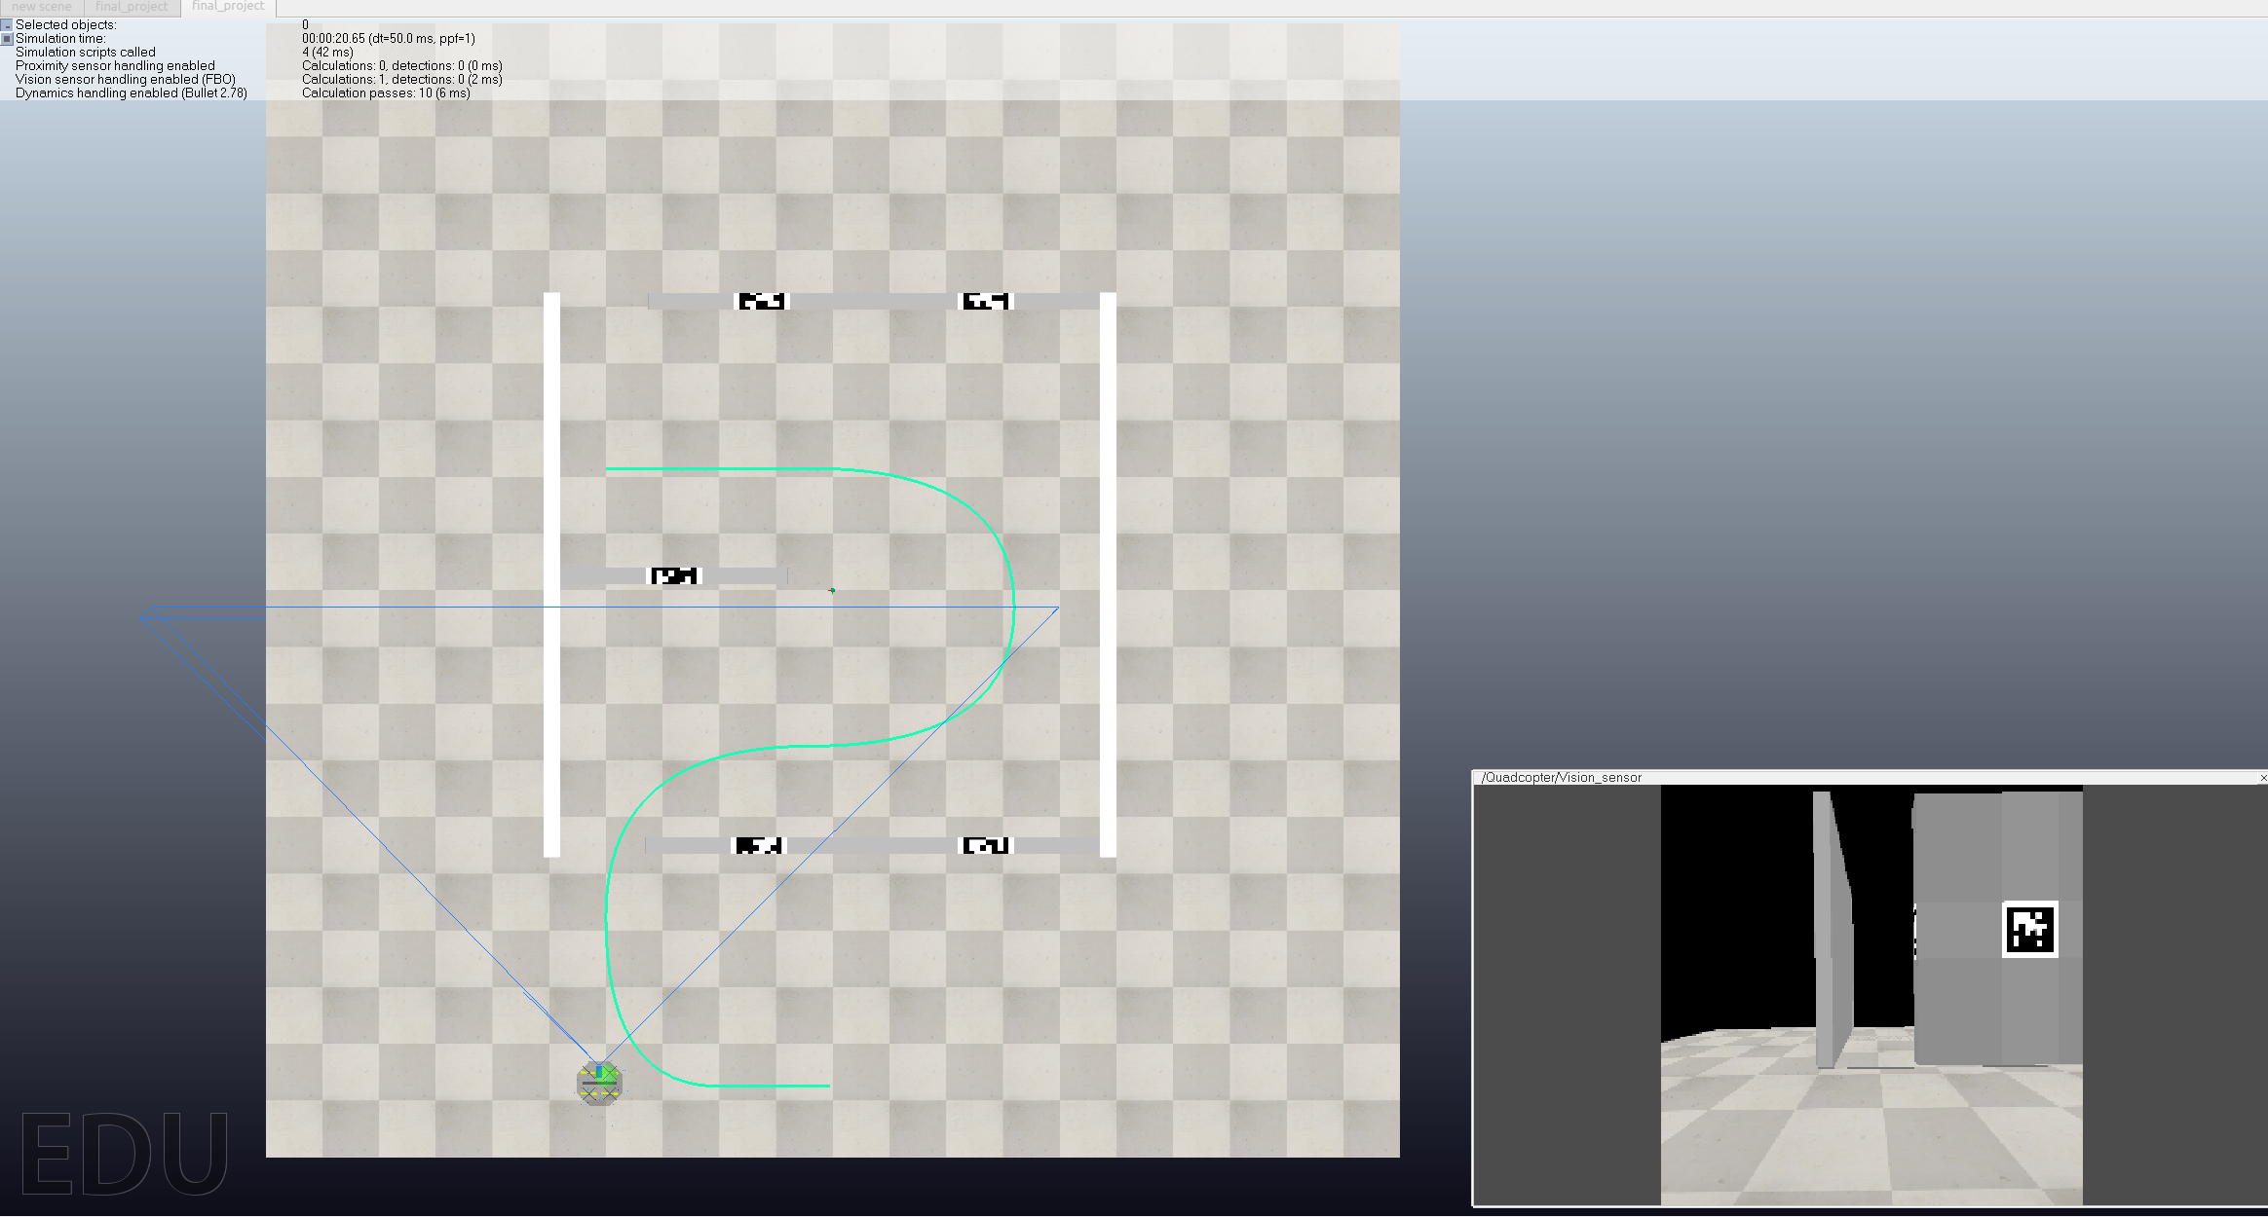
Trajectory

Slide 10
Dataset Generation
Record ROSbag With image Topic
Apriltag ROS Node
Train,Test and Validation Set
Manual Annotation

Slide 11
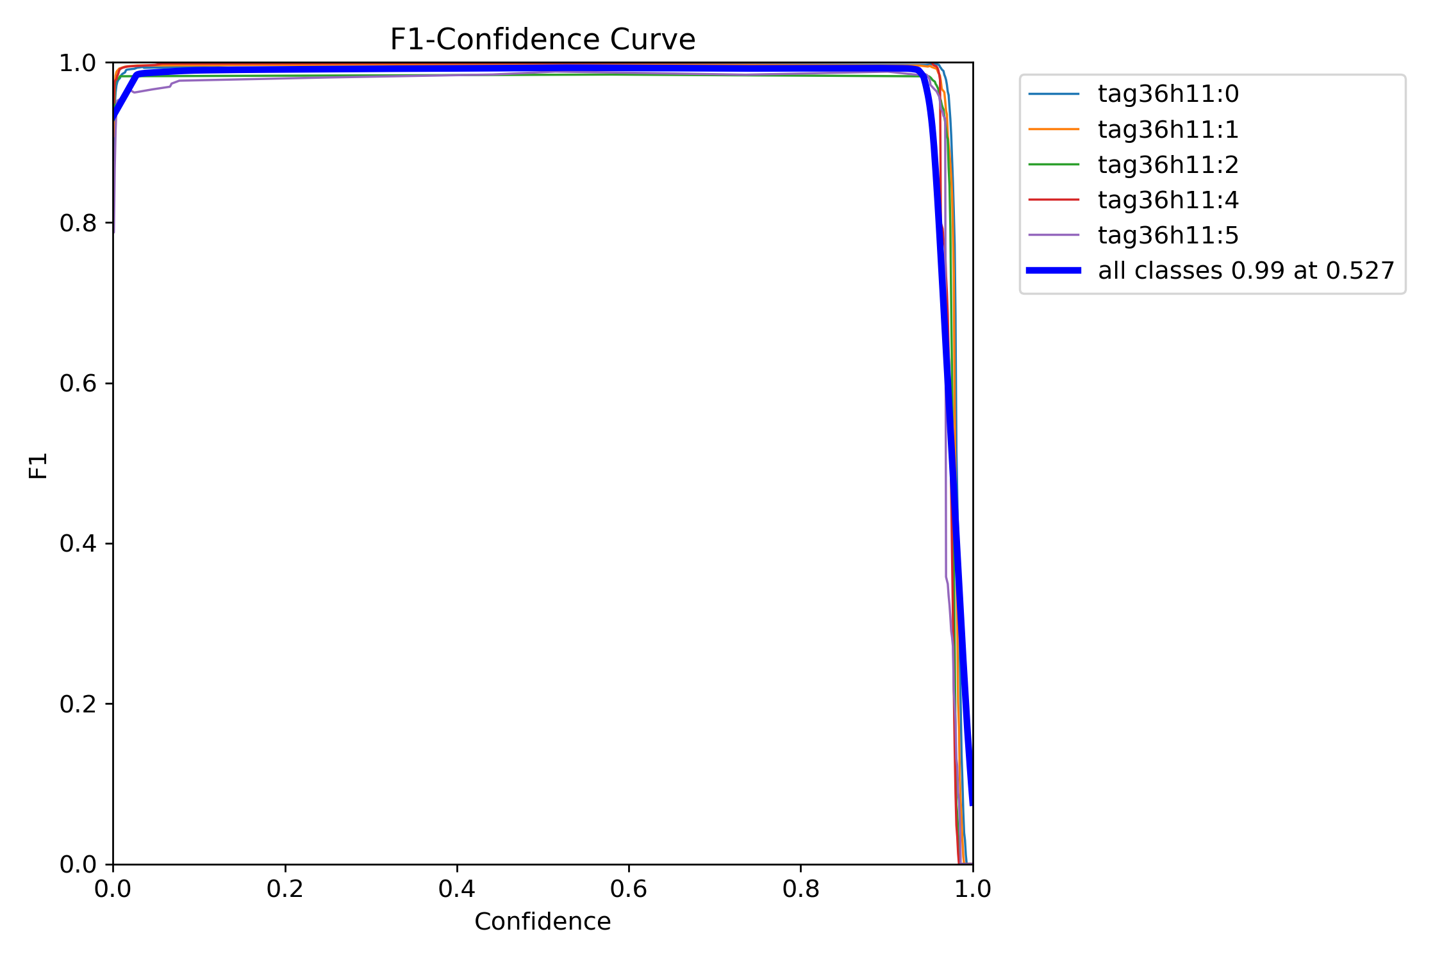
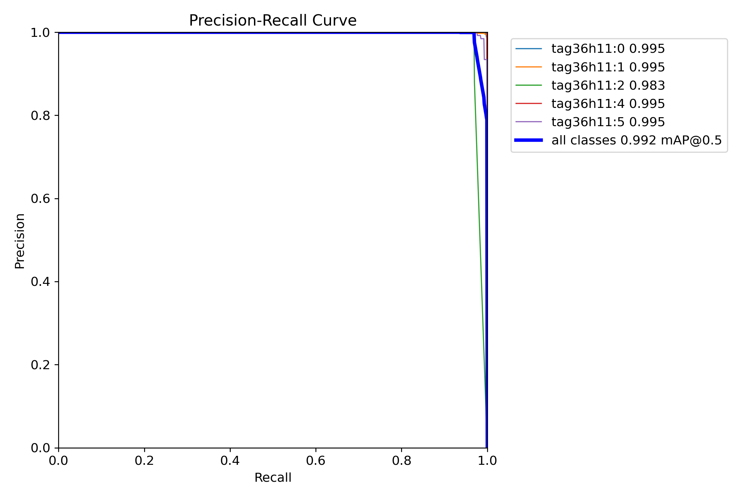
Training YOLO
The model underwent 10 epochs of training, building upon the pre-existing weights from the nano model. During the training process, the accuracy achieved was remarkably high, reaching approximately 99%. Subsequent to the completion of the training phase, the optimal set of weights was selected for further utilization.

Slide 12
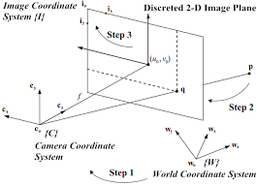
4D POSE ESTIMATION FOR QUADROTOR UAVS
Maximum likelihood estimation of the UAV pose by minimizing reprojection error of detected markers with respect to known marker positions using EPnP algorithm, leveraging multiple markers for improved accuracy and precision.

Slide 13
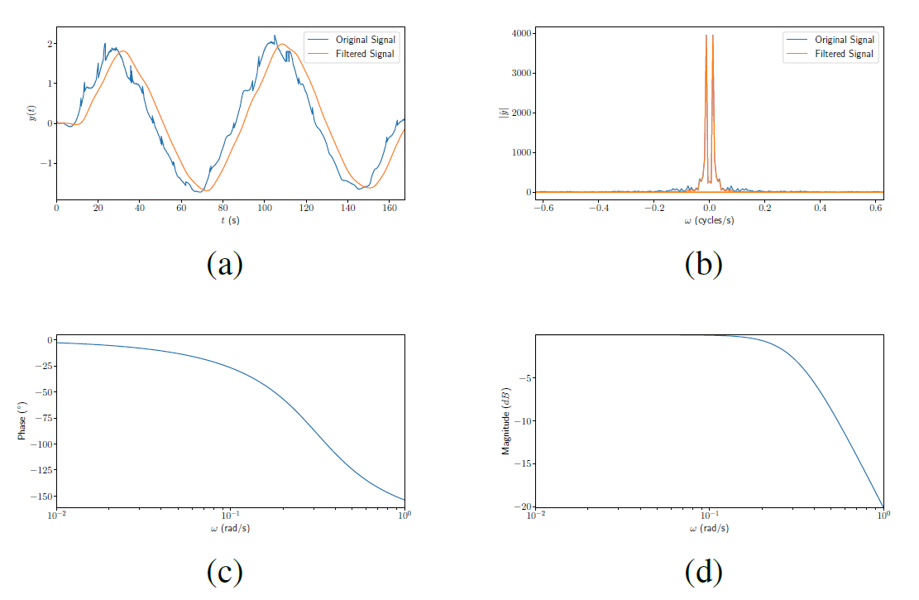
NOISE SUPPRESSION
A second-order Butterworth lowpass filter is used to reduce noise in the state estimates obtained from the YOLO V8 object detection algorithm and the EPnP (Efficient Perspective-n-Point) camera pose estimation algorithm for indoor UAV (Unmanned Aerial Vehicle) localization.
The filter is designed and analyzed in both time and frequency domains to optimize its cutoff frequency, ensuring effective noise reduction while minimizing phase shifts and time delays, thereby improving the quality of the UAV's trajectory data.

Slide 14

Trajectory Tracking with Vision-based Localization

Slide 15
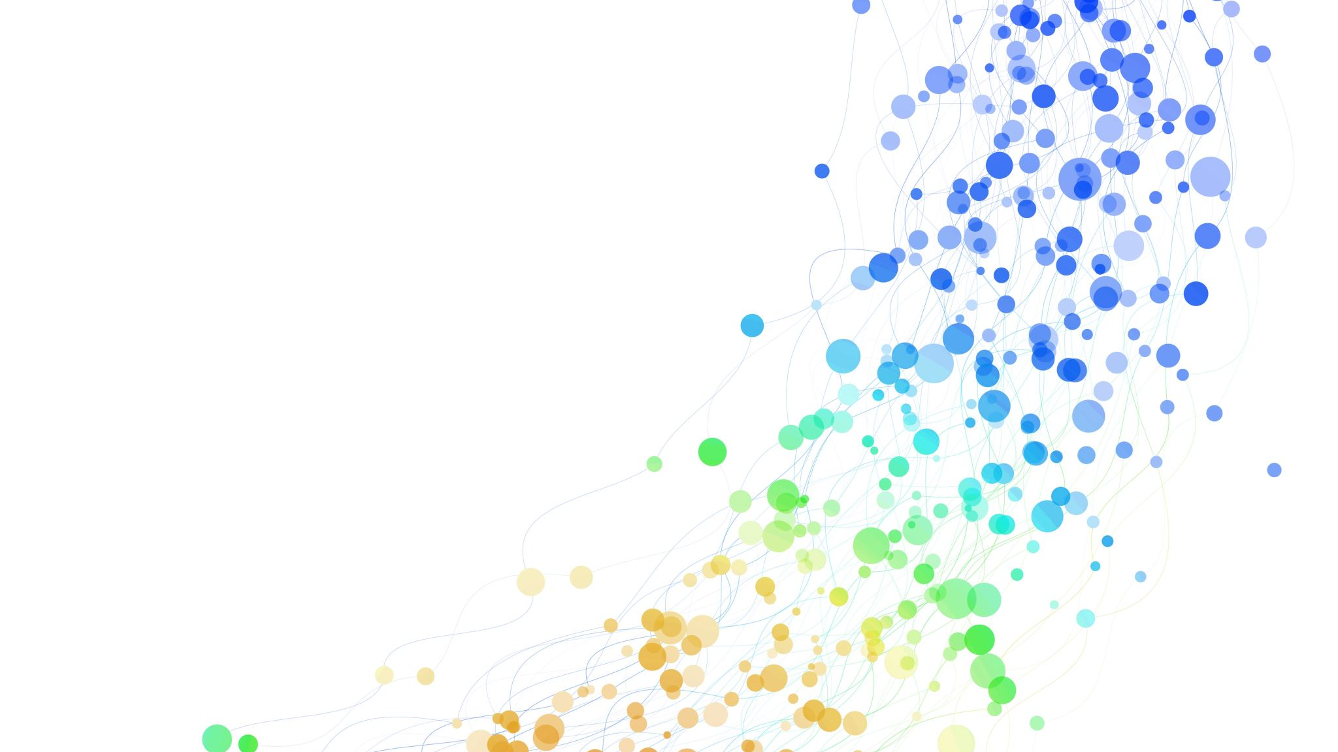
Thank you!

